Slide 1
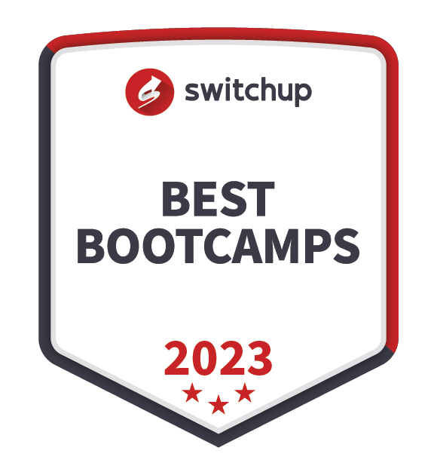

//Developers_Institute_
TLV Coding Bootcamp
</Build a coding community with us>
Developers Institute ranked for Best Coding Bootcamp Worldwide for 2023
México 🇲🇽 - Cameroon 🇨🇲 - Senegal 🇸🇳 - Burkina Faso 🇧🇫 - Togo 🇹🇬 - Mauritius 🇲🇺 - Ethiopia - Kenya - Israël 🇮🇱

Slide 2
The Ecosystem

Slide 3































The Israeli Industrial Ecosystem - a Huge Offer
Technology and Software Development
Healthcare and Biotechnology
Telecommunications
Some domains are “absorbent”, others are “transitory”
Defense and Security
Retail and e-commerce
AgTech
And many other fields…

Slide 4
The Industrial Process in which you’ll work is FIXED
Map the Data from the application / software
Release, clean, structure, normalization
Query it
Vizualize
Predict
Analyze
Back End & Data Engineering
Data Analysis
Data Science

Slide 5

Knowledge Scope
Data Science / ML Engineering
Data Analysis / Dashboarding
SQL
Python / R
Statistics & Probabilities
ML Algos Optimization Methods
Integration Tools
SQL
Python / R
Statistics & Probabilities
Visualization Tools
SQL / Python
Big Data Technologies
Data Integration and API technologies
DB Management Systems
ETL processes
DBA / Data Engineering / Data Architecture

Slide 6
The Title

Slide 7
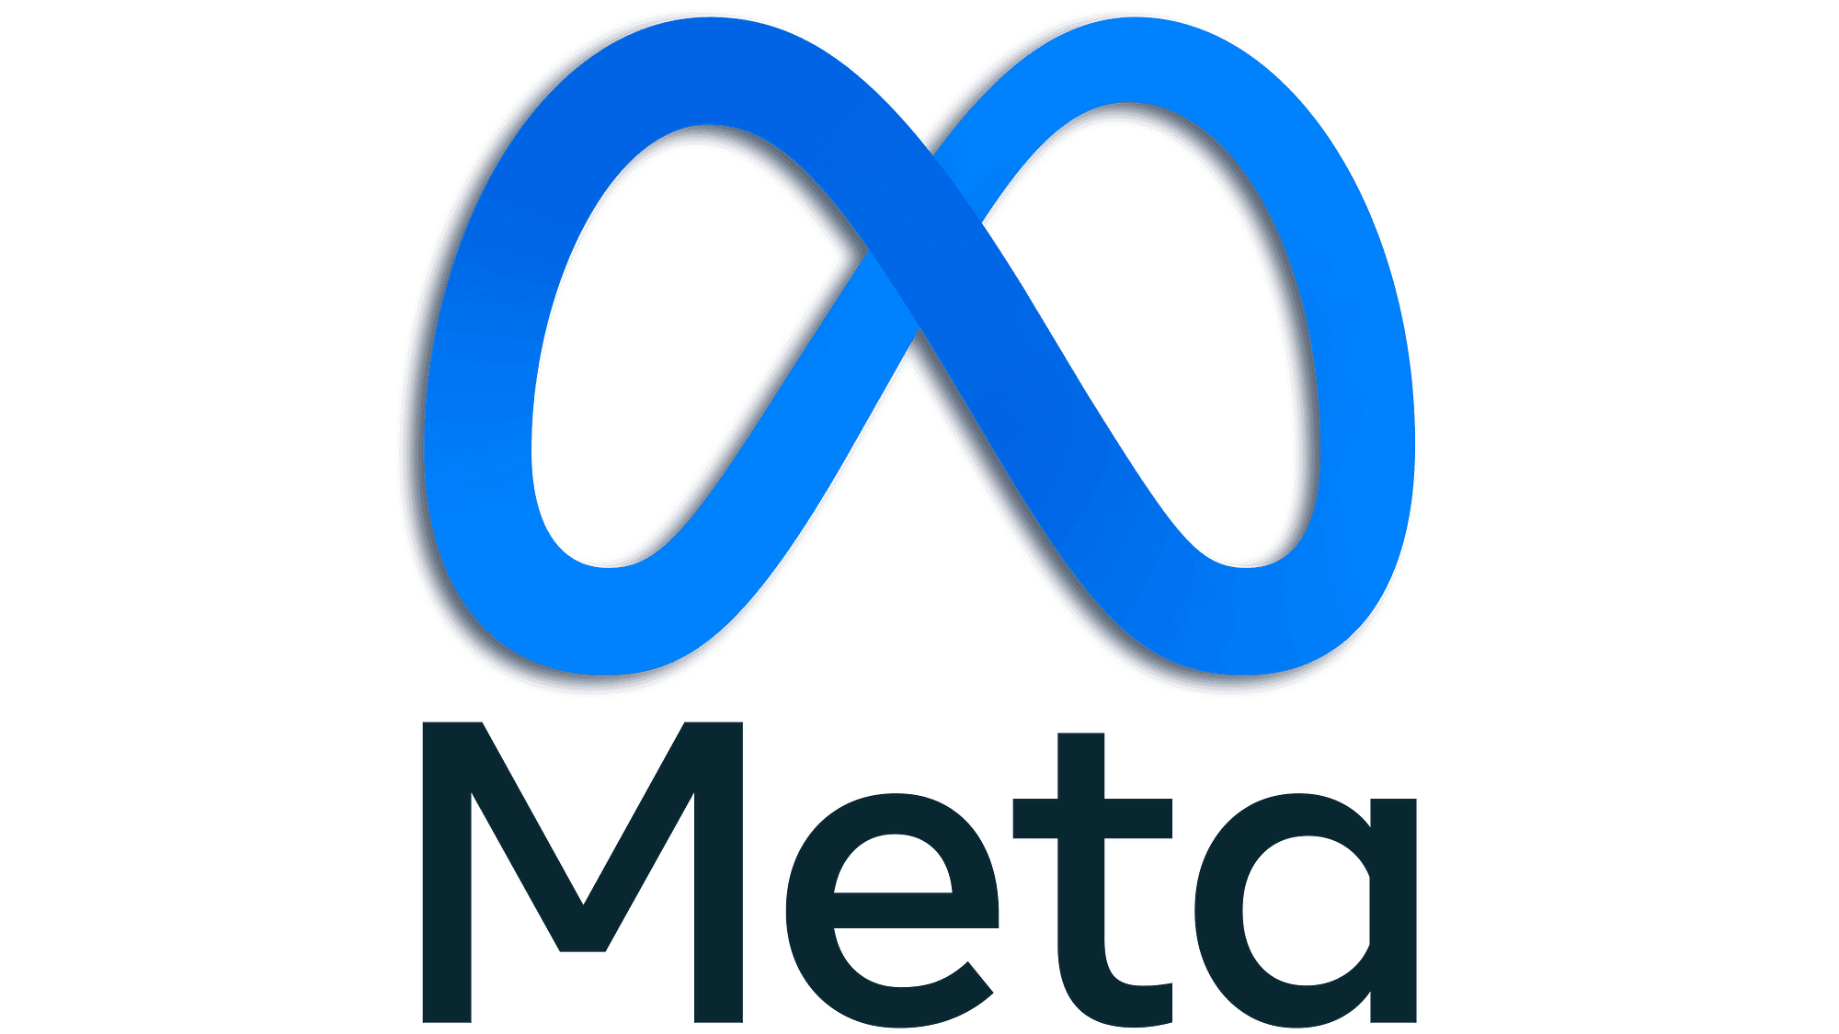
The Title Does NOT Tell About the Job
Data Scientist: actually a data analyst position
Data Scientist: hardcore NN applications
The Title Does not Tell About the Job

Slide 8

The Title Does NOT Tell About the Job
Ask and search for jobs by the skills you want to acquire / deepen, not by title. Same title can have two completely different meanings.
Fraud Analyst
Data Analyst
Data Consultant
Statistical Analyst
Decision Scientist
Prediction Modeler
Quant Analyst (Quant)

Slide 9
The Title Does NOT Tell About the Job
Be proactive during the recruitment process.
Who will be my manager? (search him on Linkedin)
Is he techy? Or more “product”?
Why does he need me?
Who will I interact with? Which teams?
Who will be my team members?
What are their professional and academic backgrounds?
Try to evaluate the gap between the job title & description and the truth
Which tools and techniques do they use?

Slide 10
From the Recruiter’s Point of View

Slide 11
Recruiters Screen Your Personality With a lot of Criteria & Biases
Is he independent?
The best WLB companies have a real “company culture”. The recruiter will make his best to match this mindset.
Geek?
Team worker?
Ambitious?
Too strong personality?
Too introvert?
Pretentious?

Slide 12
You Have to Pass the 1st Step
The 1st step of recruitment is usually done by HR:
They are like bots, they need to match key points and keywords.
Their idea about the field is VERY vague.
Make sure your CV matches the requirements of the job description or more.
The 2nd step of recruitment is usually done by the manager:
He has a checklist for skills and experience.
A PERSONAL idea of what your personality should be.
A will to hire somebody who will relieve him from tasks and work and DELIVERS 100% reliable results.

Slide 13
From Your Point of View

Slide 14
Non Negotiable
Suitable Technological Environment:
Big data technology?
Which tools do they use to make their analyses?
Which data warehouse system?
Research-to-integration process tight?
A team you can learn from:
You HAVE TO know who will be your direct colleagues.
Prioritize jobs where there is a team, otherwise the odds are high that you’ll remain alone for a long time.
A job you’ll be able to easily “sell”:
Renowned industry field?
Cutting edge technology and tools?
How about AFTER this position?
Prioritize companies where you can move forward to other positions.

Slide 15
Employment Conditions
You must investigate the hiring conditions BEFORE and know those 4 parameters:
Salary (and social conditions)
Bonuses
Stocks / options
Vacation
Sites like GLASSDOOR can help you investigate things.
Salary:
Juniors start around 20k but it’s HIGHLY variable depending on what you ask and your background.
Ask something and always mention that you are flexible and prioritize experience
Bonuses:
Recruiters will tell you about this only upon sending you an offer. You have to ask or investigate.
Don’t expect a lot, max 2 salaries yearly with a lot of “ifs”...
Stocks & options:
Companies have salary-to-stock/options to meet..it is defined by boards.
Ask about the vesting period.
Check trends!
Vacations:
Some companies apply the unlimited policy.
For others, minimum 18 days.
It’s negotiable! But before signing.

Slide 16
StartUps
They require the most efforts investigating potential. Think twice before diving!
Salary:
lower
Bonuses:
rare
Stocks & options:
Can be game changer…but it’s a bet.
Vacations and WLB
bad.
They can be great places to learn and gain responsibility, but it’s often on the account of your WLB.

Slide 17
There is a position for you…find it! Good Luck

